Slide 1
Co – Program Management
Program Management Office (PMO)
Notes:
You’re here today so we can show you how we plan to structure Enterprise Accounts moving forward to service you better.
There have been many changes within our company during the last year. Our mission, structure, methodology and processes are evolving. All of this will enable us to provide you with a stronger, more comprehensive service.

Slide 2
Overview

Slide 3
Our Client’s Objectives
Maintain synergies across marketing channels
Architect functional websites with brand distinctions and site usability
Acquire and retain customers by providing a superior site experience
Ensuring cost effective and timely internet development services
Utilize new technologies
Develop actionable measurement and reporting

Slide 4
Enterprise Client Challenges
Create a long term relationship over many successful projects
Manage Project Interdependencies
Scope Management
Client participation in account planning (Define Future Opportunities)
Managing growth
Actionable measurement and reporting
Ensuring cost effective and timely service delivery

Slide 5
Sales Focus
Marketing
Sales
Channel Partners
PROSPECT IDENTIFICATION
Marketing, Sales
Business Development
LEAD QUALIFICATION
CONSULTATION
Sales + Delivery
Delivery Focus
Sales + Delivery
PMO Members as needed
PRESENTATION(S)
JUSTIFICATION
Sales + Finance + Delivery
PROPOSAL
Delivery + Sales
+ PMO Members as needed
Schedule
Sales + Delivery
Transition to PMO
Execute
Delivery

Slide 6
Program Management Organization
Centralized operations unit for a client for all Advice projects.
Defined organization rather than temporary project team
Partners with client management to work together with set of defined processes
Accountable for:
Project Delivery
Communication
Risk management
Issue resolution
Contract administration
Client satisfaction.
Why a Program Management Office?
To address the dependencies between projects for a single client
Provide centralized oversight of all Client work
Provide organization to insure consistent quality of delivered projects

Slide 7
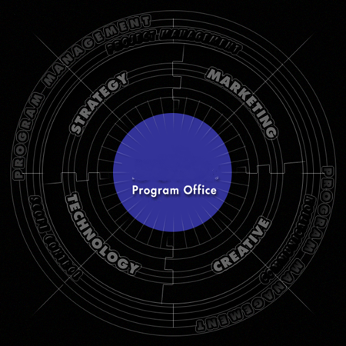
PMO Overview
Planned, scalable structure
Centralized oversight
Consistent quality of deliverables
Manage risk and dependencies
Bring all capabilities to the table
Notes:
The Program office is an innovative and complete solution to meet current business requirements and future goals.
The program office is the best way to achieve value through a complete range of services
A key feature of our program is an ongoing dialogue between all stakeholders

Slide 8
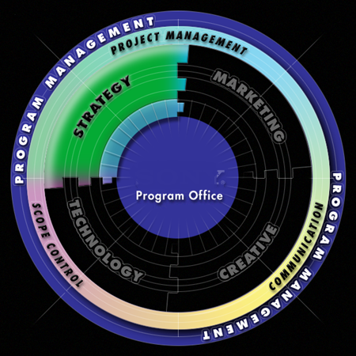
Strategy
Multi-level strategic engagements
Industry research & analysis
Analysis of new technologies
Identify opportunities for competitive advantage
Identify and reach target audiences

Slide 9
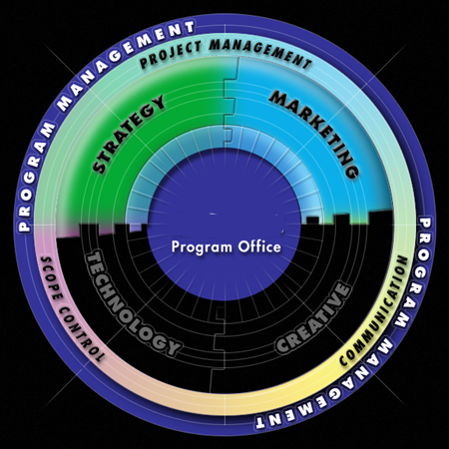
Marketing Services
Global positioning
Convey brand distinctions & messaging
Search Engine Optimization
Paid Search
Social (paid and earned)
Content
Web Analytics
Campaign management
Online media planning / buying
Measurement and reporting through the capture & analysis of data

Slide 10
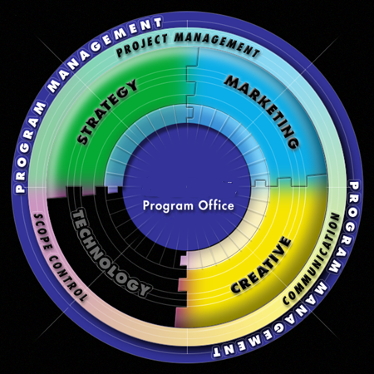
Creative
Compelling experience
Usability studies
Compelling creative
Content management & enhancement
Digital branding

Slide 11
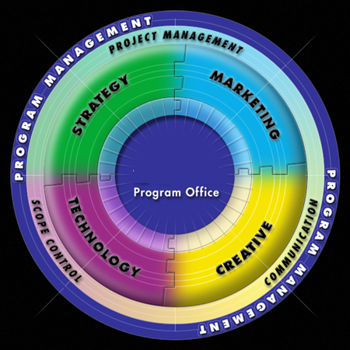
Technology
Systems integration
Architectural design & evolution management
Reliability
Configuration & release management
Security & privacy

Slide 12

Program Management
Management reporting to accelerate decision making
Focal point for efficient deployment and utilization of resources for a client
Standards to effectively manage the program
Targeted communication
Vendor & contract management
Risk management
Knowledge management

Slide 13
Program Office Structure
Executive
Client Service Team
Account Team
Project Administration
Project Delivery
(PM’s Added as needed)

Slide 14
Executive - Client Service Team
Pursuit leadership
C-Level client contact
Negotiates contracts (SOW)
Business case development
Delivery management
Project Estimation and Pricing
Delivery oversight
Project planning / scheduling
Account profit and loss ( Project Economics)

Slide 15
Account Team – Project Administration
Client satisfaction - day to day
Additional opportunity identification
Support specialists:
Marketing and Site strategy
Creative
Technology
SEO
Social
Content

Slide 16
Project Delivery – Ongoing Services
Daily issue resolution.
Traffic tracking of piece work.
Small content churn.
Coordinates with:
Program creative and technical directors.
Hosting and content providers.
Issue and opportunity escalation to program manager.
Chartered with piece work. No upper limit on revenue.

Slide 17
Project Delivery – Small Project
Account team coordinates work direction
Staff effectiveness and timing
Client milestone sign-off and expectation management
Manage defined scope
Chartered with several $20k+ deliverables totaling less than $350K

Slide 18
Project Delivery – Large
Dedicated Project Manager
Daily project management and work direction
Project plan and schedule
Staff effectiveness and timing
Client milestone sign-off and expectation management
Scope management
Chartered with more than $200K of a single defined deliverable

Slide 19
Creative Lead
Quality of all creative delivery
Customizes process to meet the client need
Sign-off on creative deliverables
Client primary creative contact
Explains implications of creative decisions
Creative risk assessment and planning
Advises individual skill assignments

Slide 20
Technical Lead
Quality of all technology delivery
Capacity planning/scalability
Site stability and reliability
Leads software tool selection and upgrades
Client primary technical contact
Explains implications of technology decisions
Technology risk assessment and planning
Advises individual skill assignments

Slide 21

Delivery Management

Slide 22
Delivery Leadership – Next Steps
Delivery Execution on existing Clients
Enterprise Standards
Define, Document, Train, Enforce
Enterprise Reporting Standards
Define, Document, Deliver
Define Enterprise Client PMO

